Slide 1

Database Management System SAKSHAM
Submitted to : Submitted By :
Dr. Namita Mittal Khushboo Choudhary(2016ucp1469)
Sakshi Maheshwari(2016ucp1617)
Twinkal Parmar(2016ucp1700)

Slide 2

SAKSHAM

Slide 3
Introduction
The project “SAKSHAM” is a software package which has been developed to manage student’s information and scholarships details. Students can check the status of their scholarships(accepted/rejected/in progress).The portal finds the eligible students from the registered candidates on the basis of percentage,area,category,annual income and various other constraints.
This SPS is a self-contained system that stores the information of students and allows them to apply for various scholarships. Finally, it checks whether the student is eligible or not, then the eligible students receive the scholarships.

Slide 4
Functions
Two users are there,student and admin.
The student’s information is asked just once and then stored in the database for further uses.
All the details of available,upcoming and received scholarships can be viewed by the student.
The student can apply for the available scholarships and can check the status of the scholarships i.e. if the scholarship is accepted,rejected or still in progress.
Records can be retrieved when needed.

Slide 5
Database
Account Management
Each Account row shall have the following mandatory information:Username,password.
Student Information
Each student shall have the following mandatory information:Name,parent’s name,date of birth,address,state,category,family income,college name,region,economic group,bank details,educational details,document uploads.
Scholarship Information
Each scholarship shall have the following mandatory information:Name,total fund,amount per student,available scholarships,constraints i.e. age,economic group,category,etc.
Status of the Scholarship
Each status row shall have either of these three values along with scholarship id,scholarship name,student’s name and username : accepted,rejected or ‘in progress’.

Slide 6
Modules
Admin Module :
Functionalities -
Add new scholarships to the Portal.
View the scholarships applied by the students.
Verify the scholarships of the students and hand it over to the eligible candidates.
Student Module :
Functionalities -
Enter the information so that it can be saved into the database.
Update profile or account settings.
Apply for the scholarships.
View all scholarship details and the eligibility criteria.
View scholarship status.
View received,upcoming and available scholarships

Slide 7
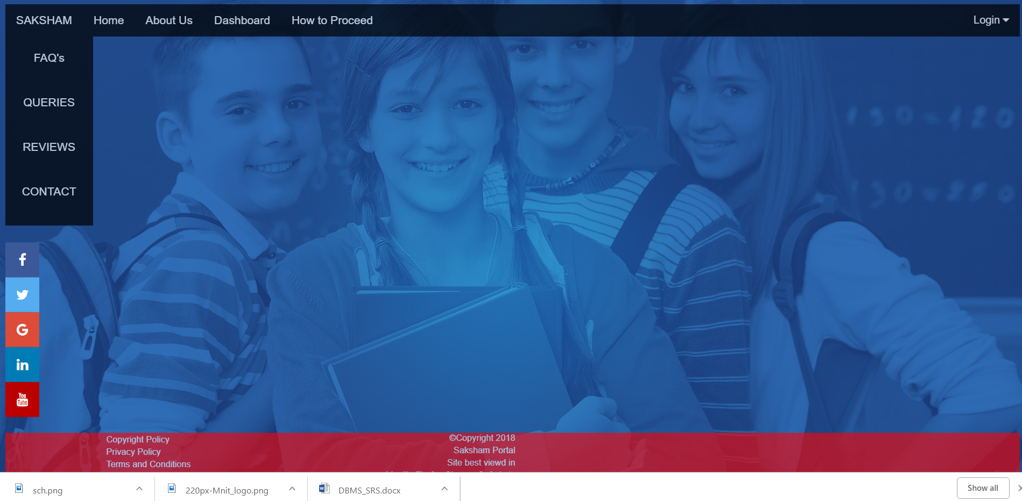
Home Page

Slide 8

Login Page

Slide 9
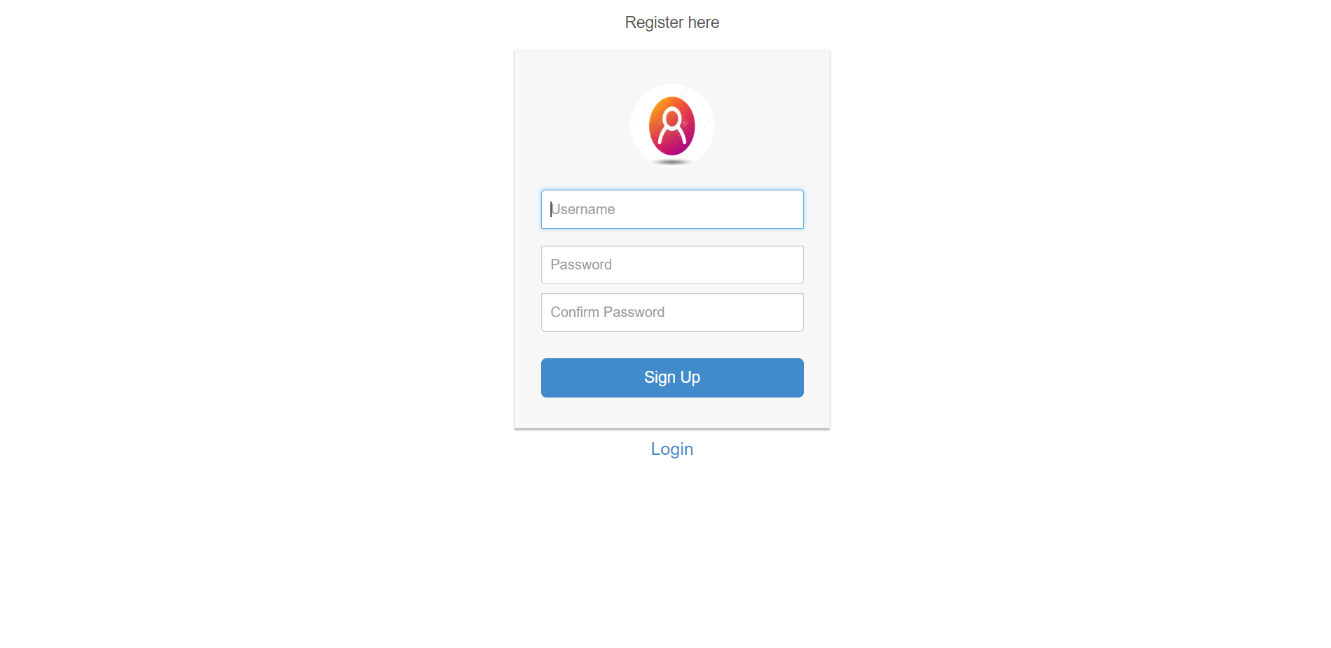
Register Page

Slide 10
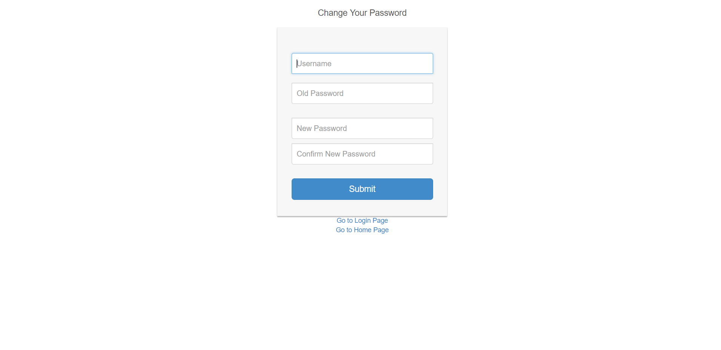
How to change password

Slide 11
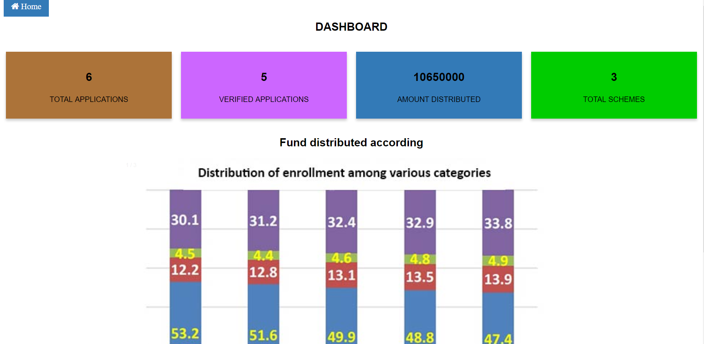
Dynamic Dashboard

Slide 12
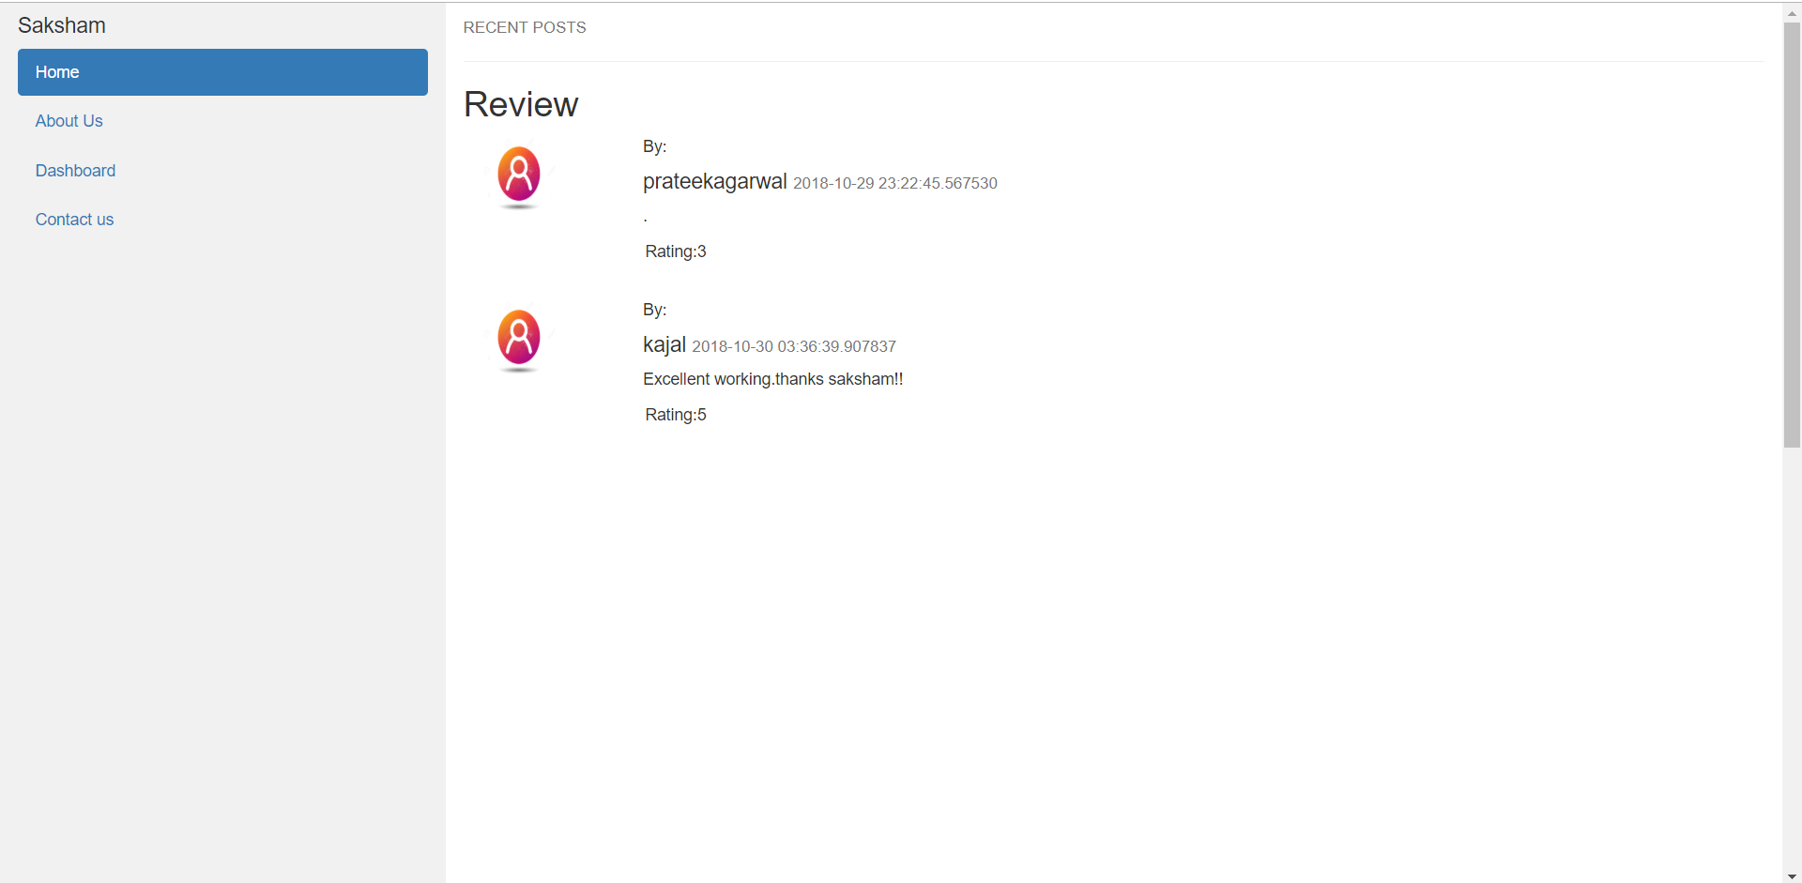
Reviews..

Slide 13
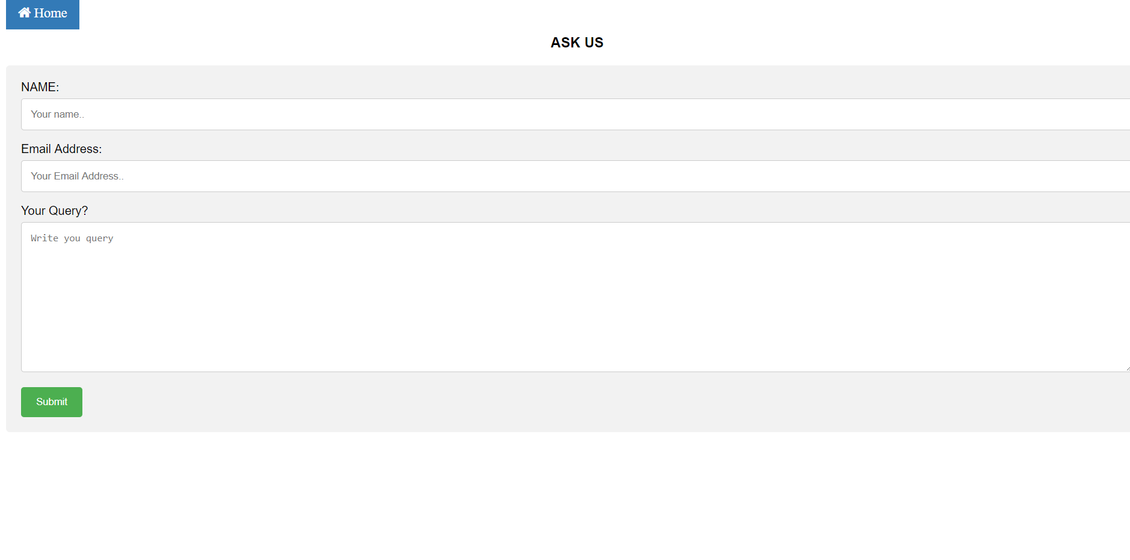
How to ask queries..

Slide 14
Functionalities of Student user

Slide 15
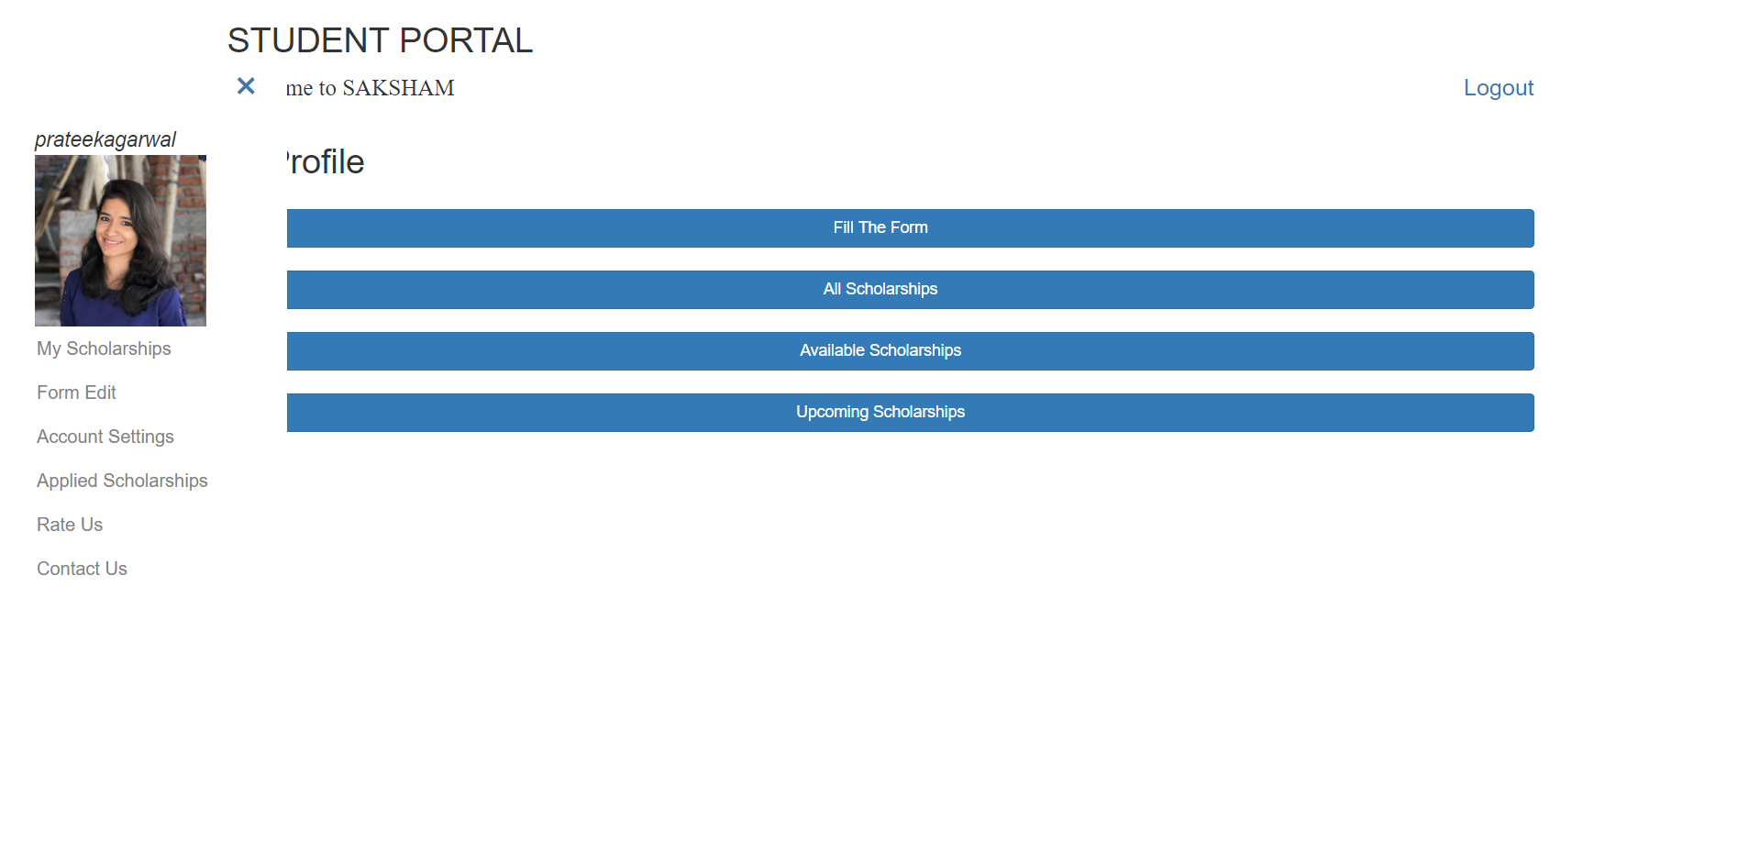
Student Profile Page

Slide 16
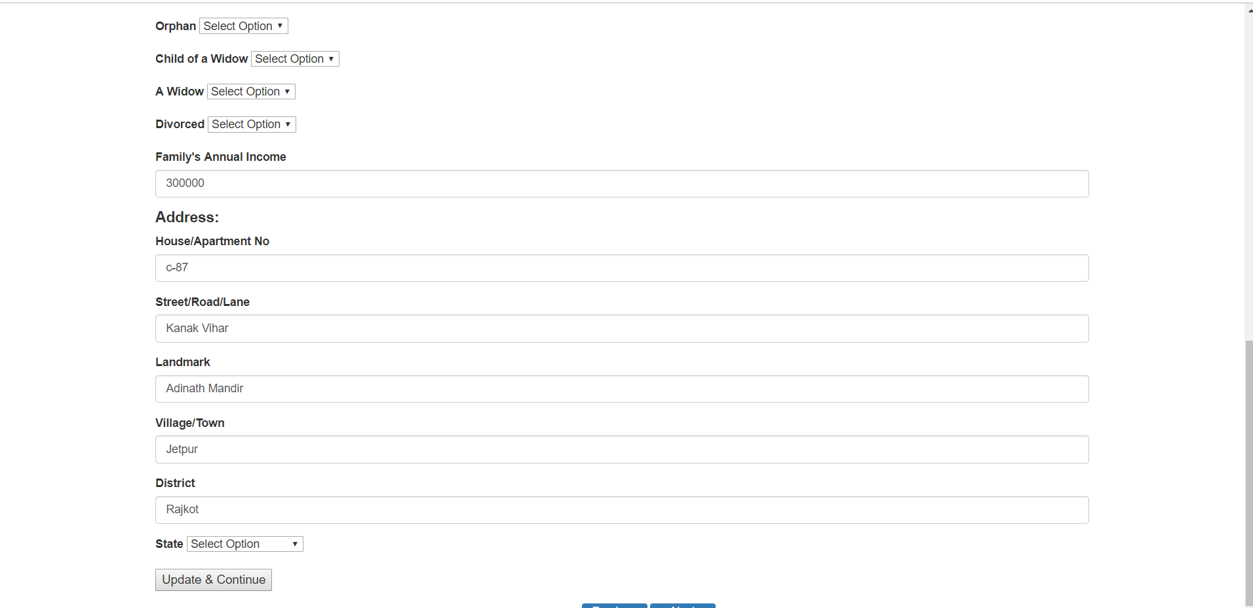
Fill/Edit Student’s Information

Slide 17
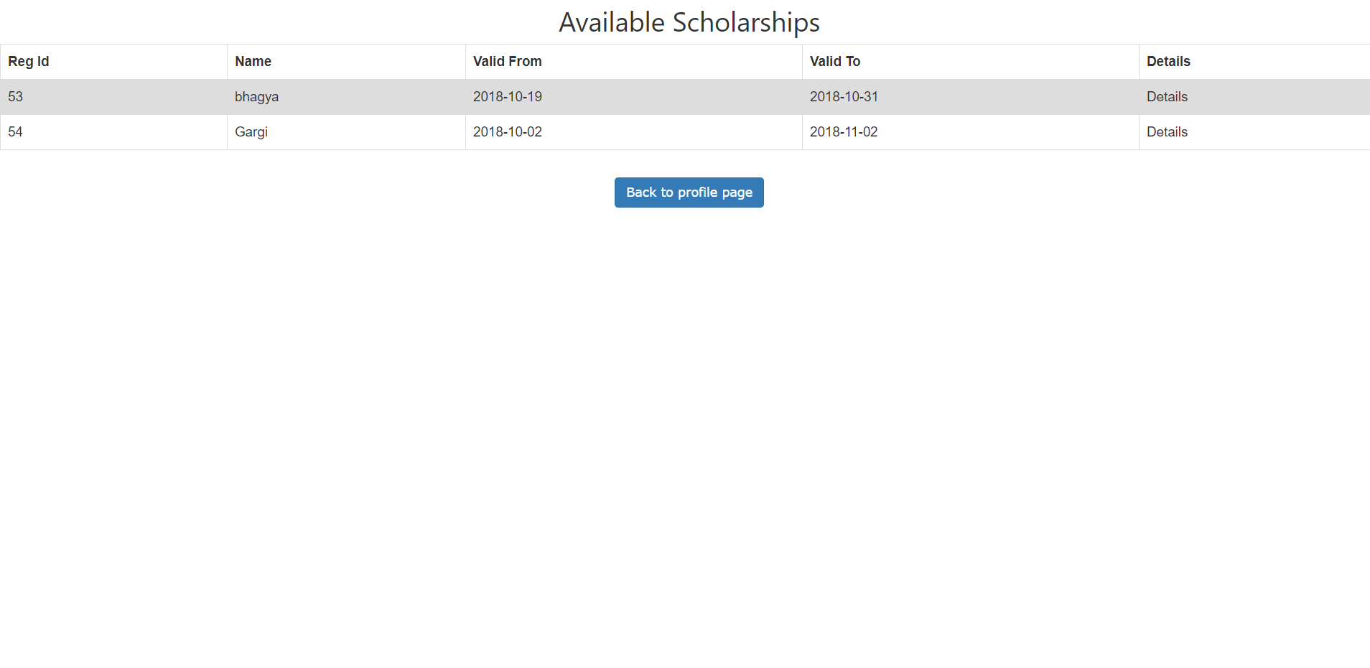
View available/upcoming scholarships

Slide 18
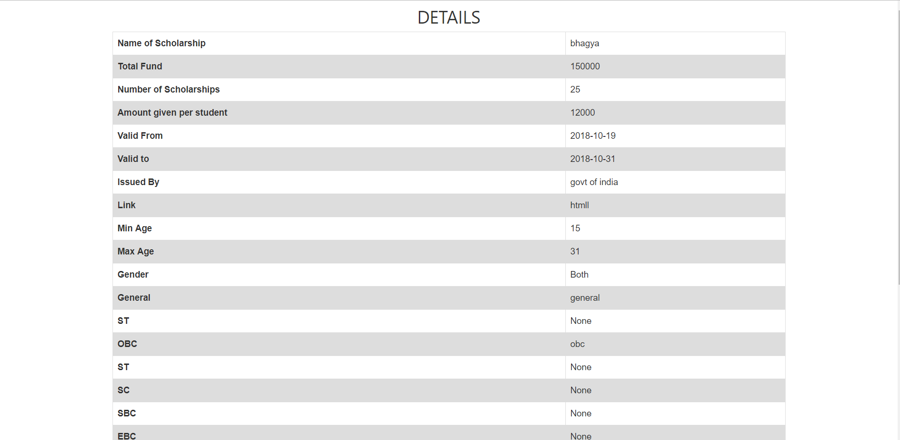
View Scholarship’s details

Slide 19
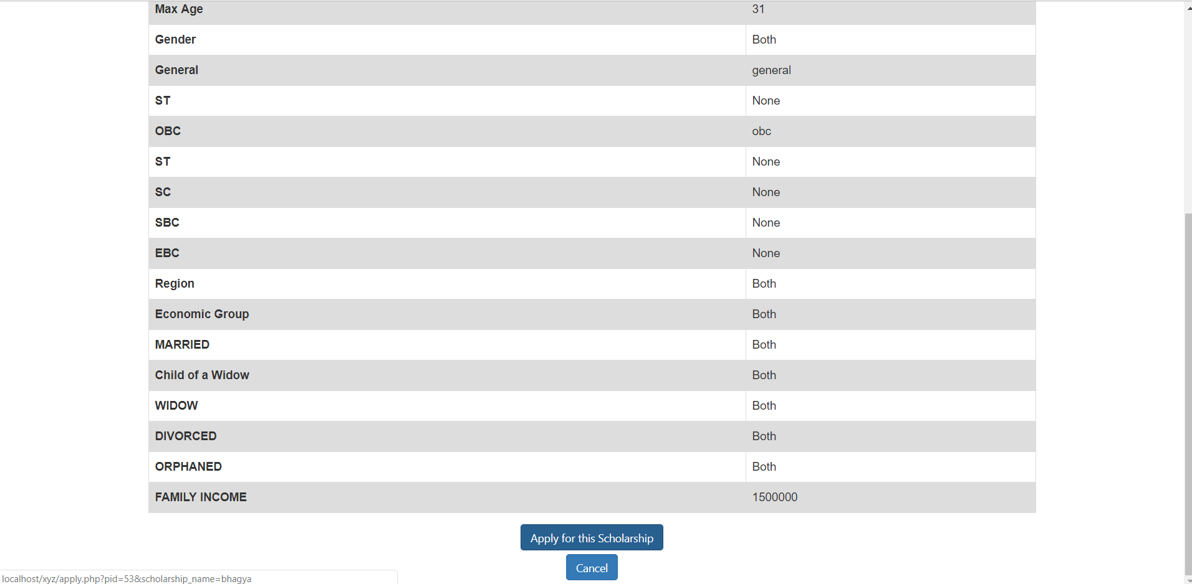
Apply for scholarships

Slide 20
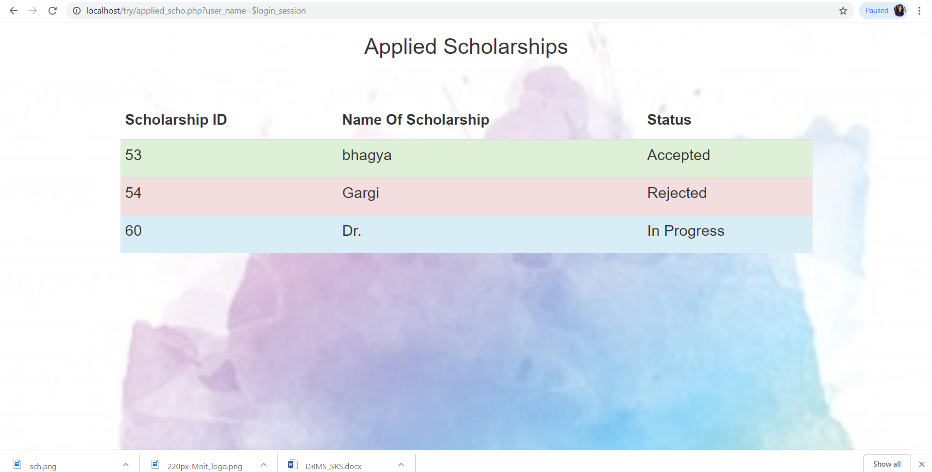
Check Status

Slide 21
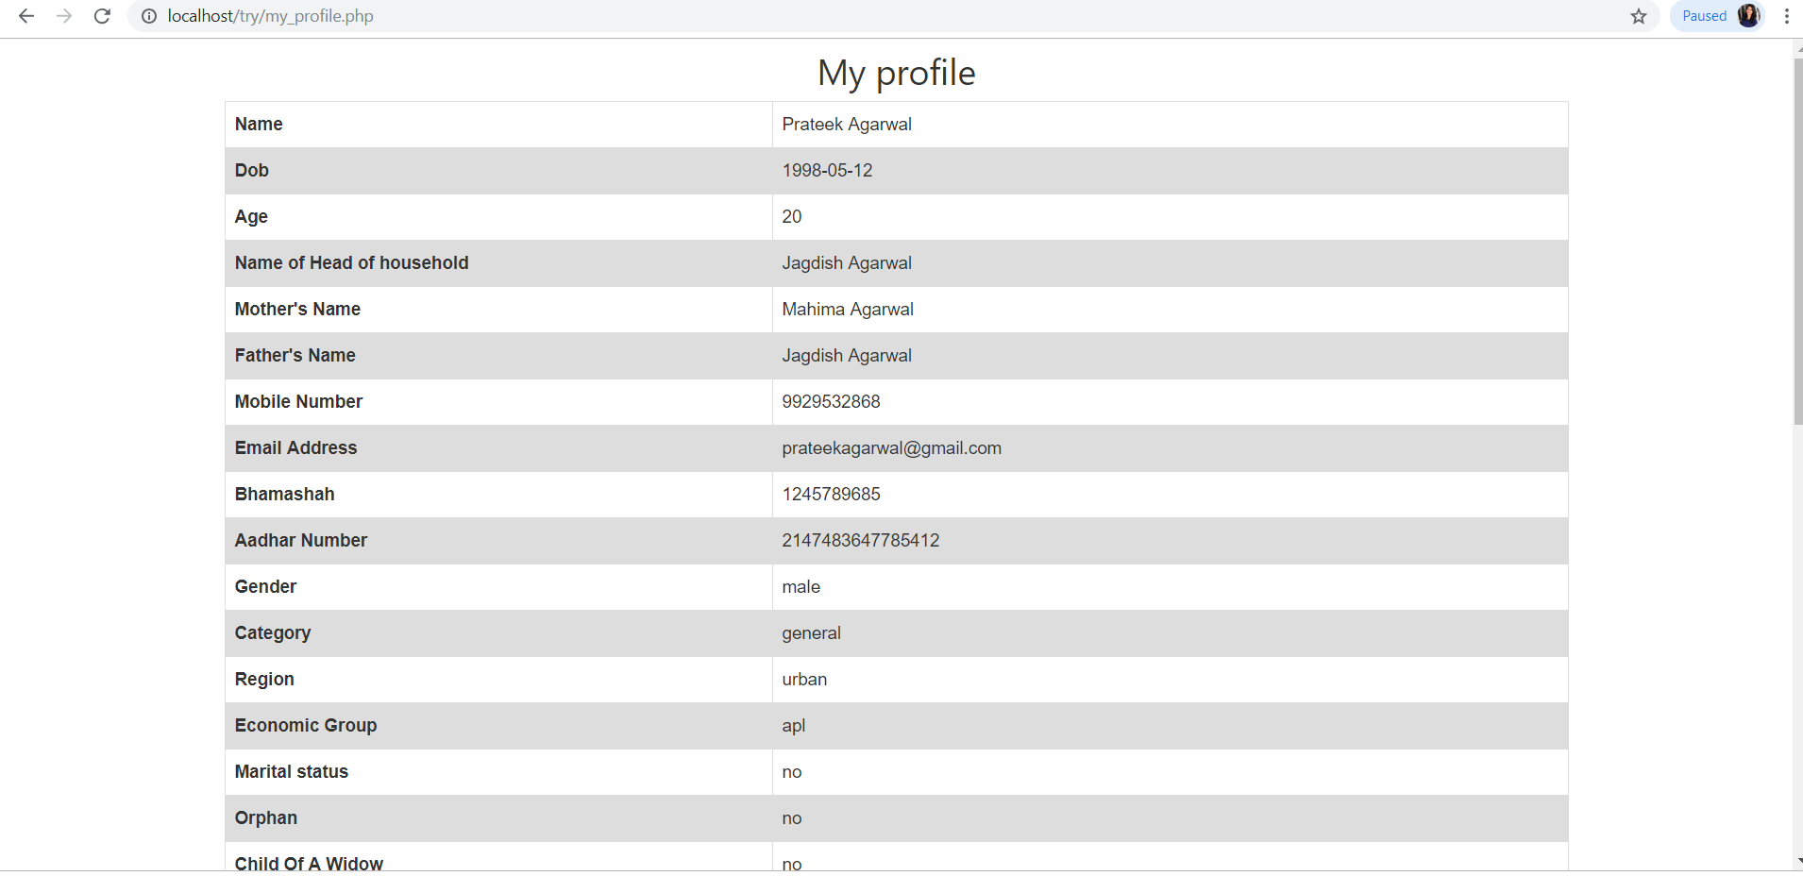
My Profile

Slide 22
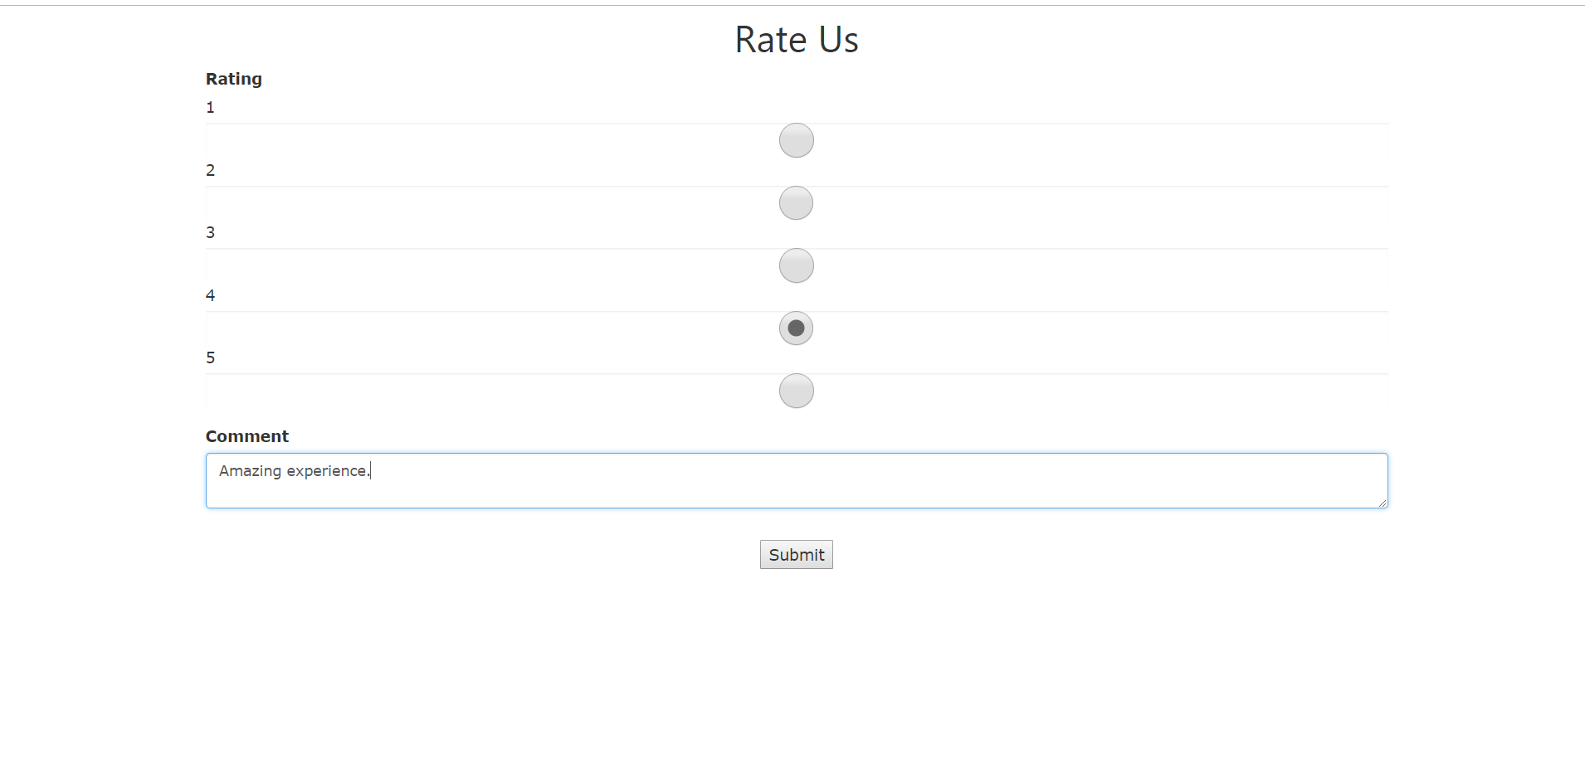
Rate the website

Slide 23
Functionalities of Admin User

Slide 24
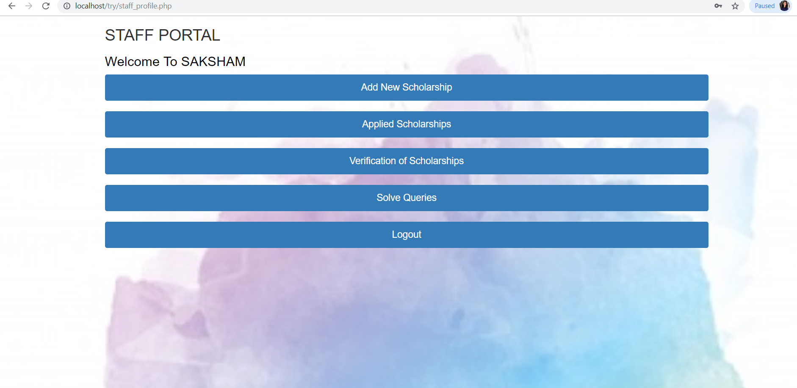
Admin Profile Page

Slide 25
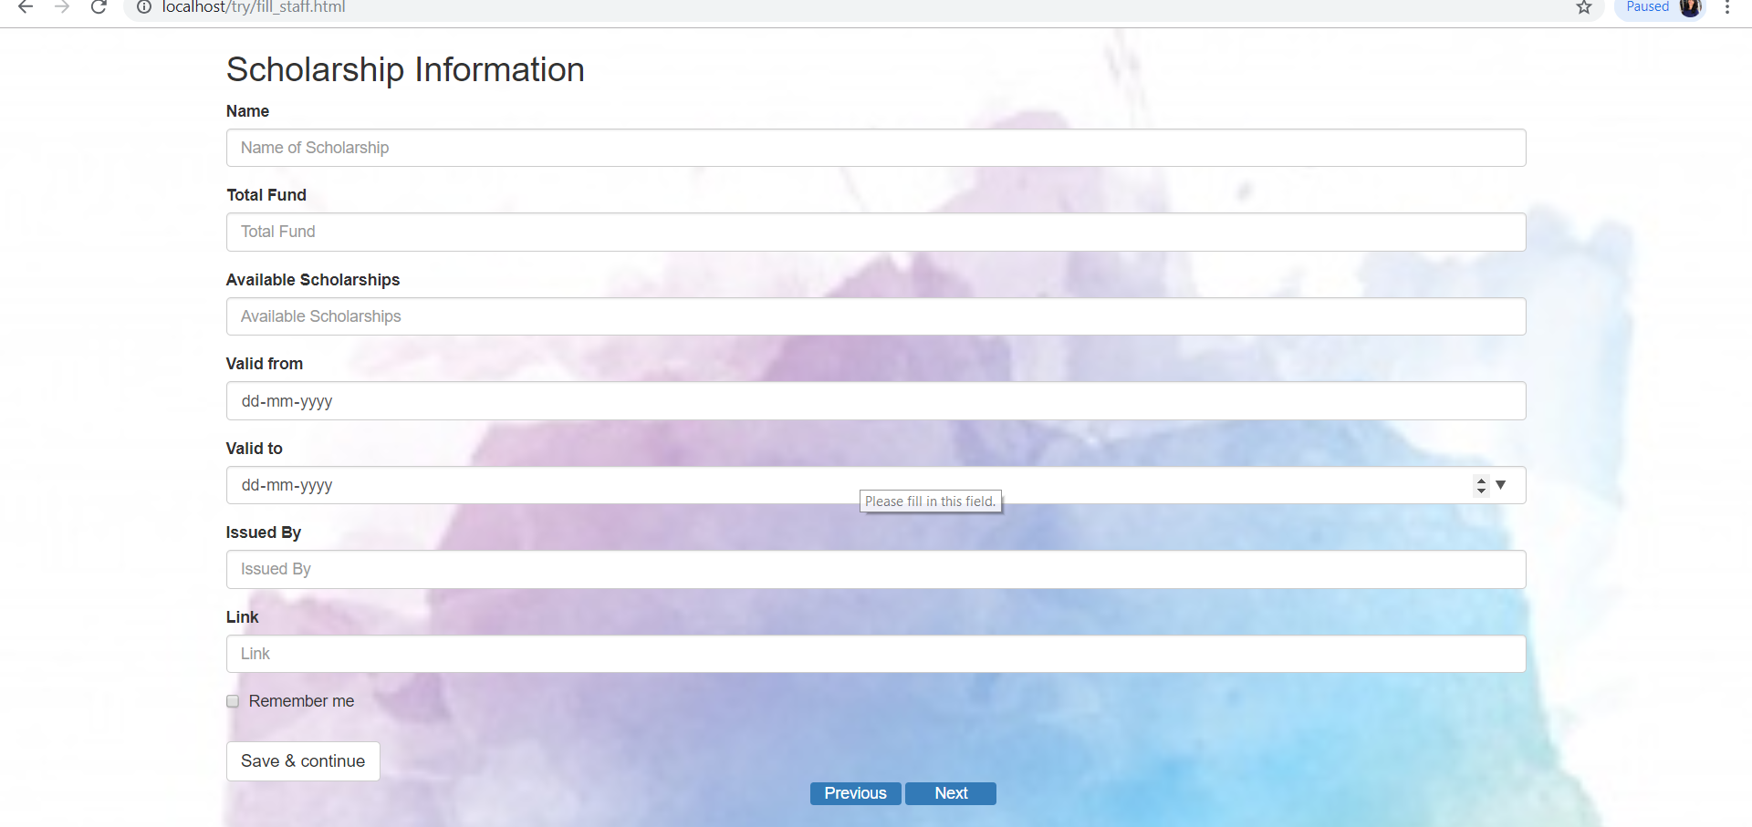
Add a Scholarship

Slide 26
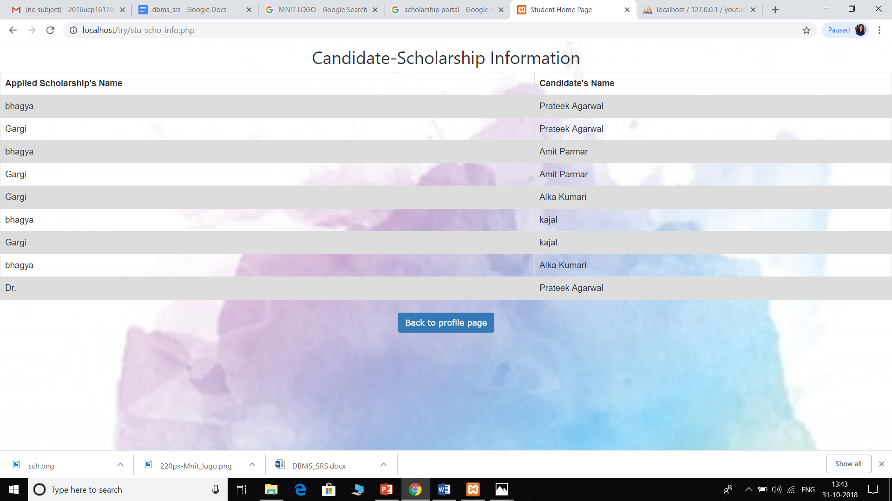
View applied scholarships

Slide 27

Verify Scholarships

Slide 28
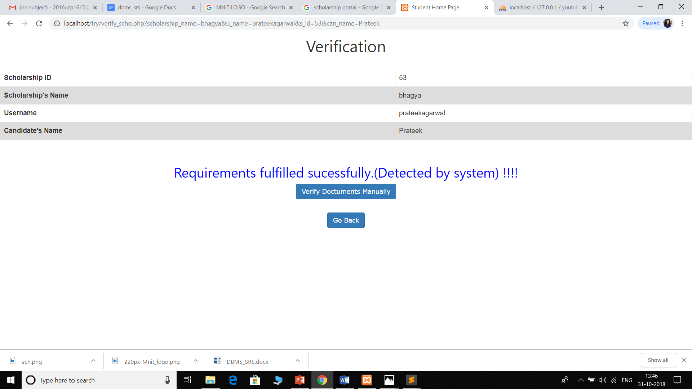
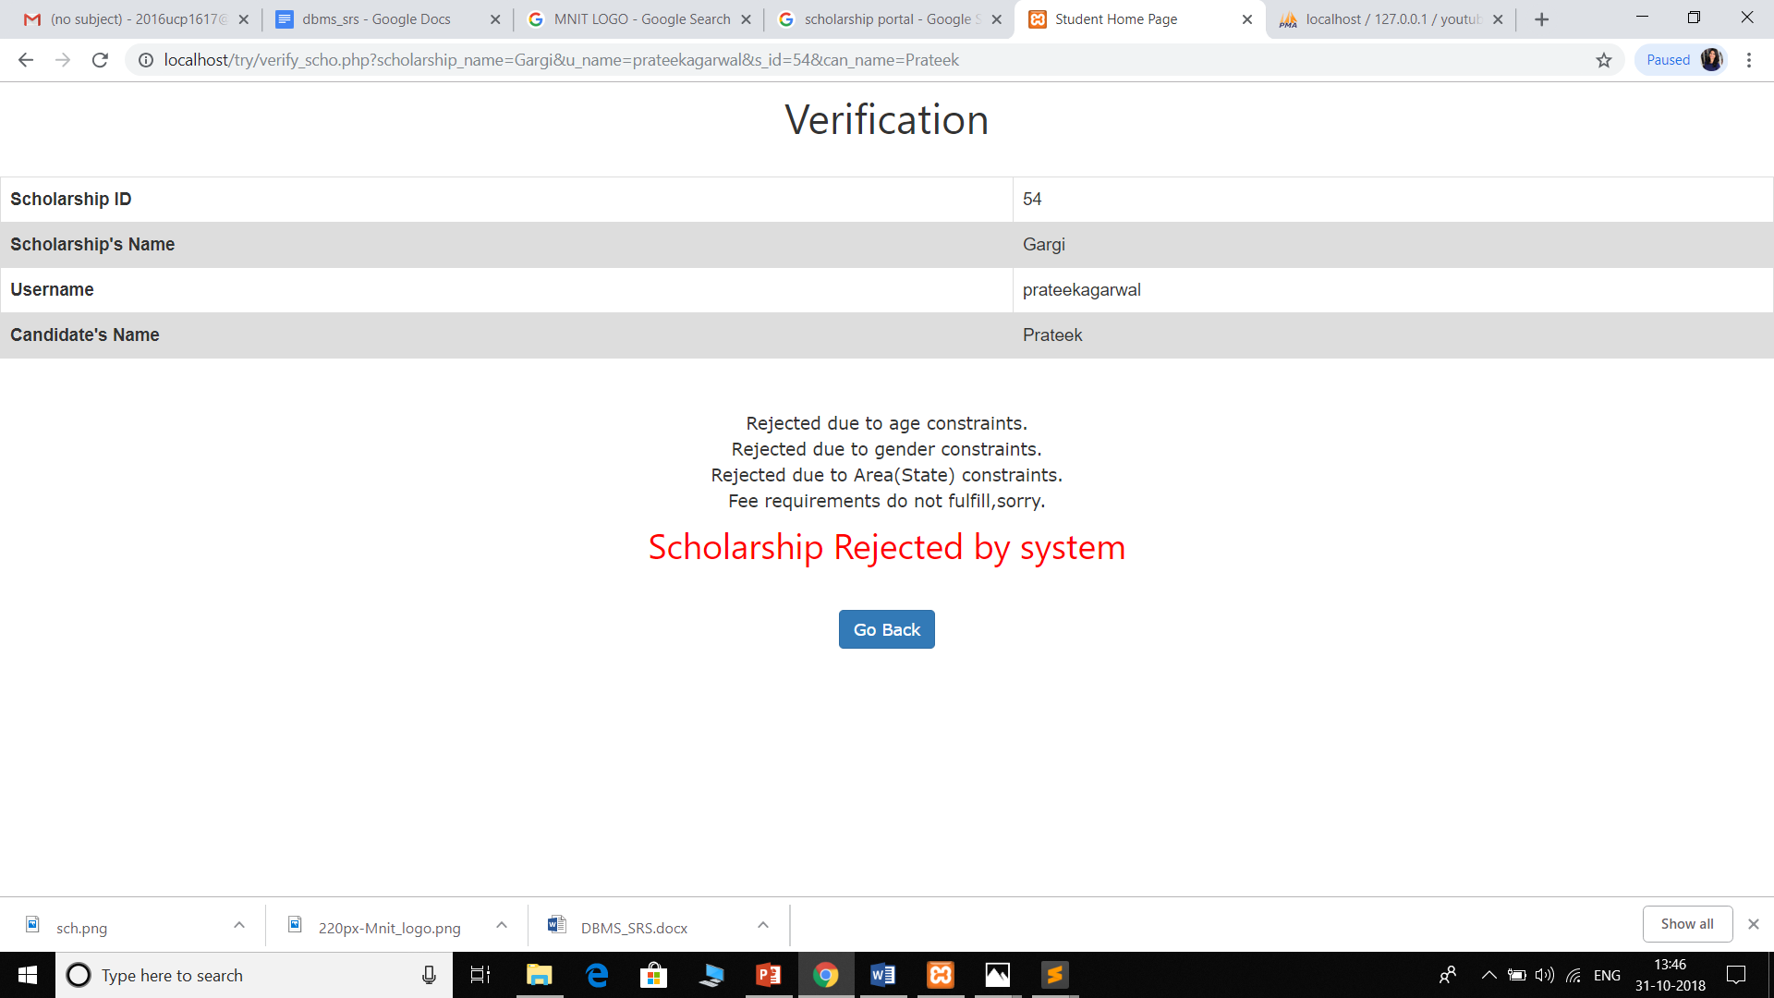
Scholarship accepted/rejected

Slide 29
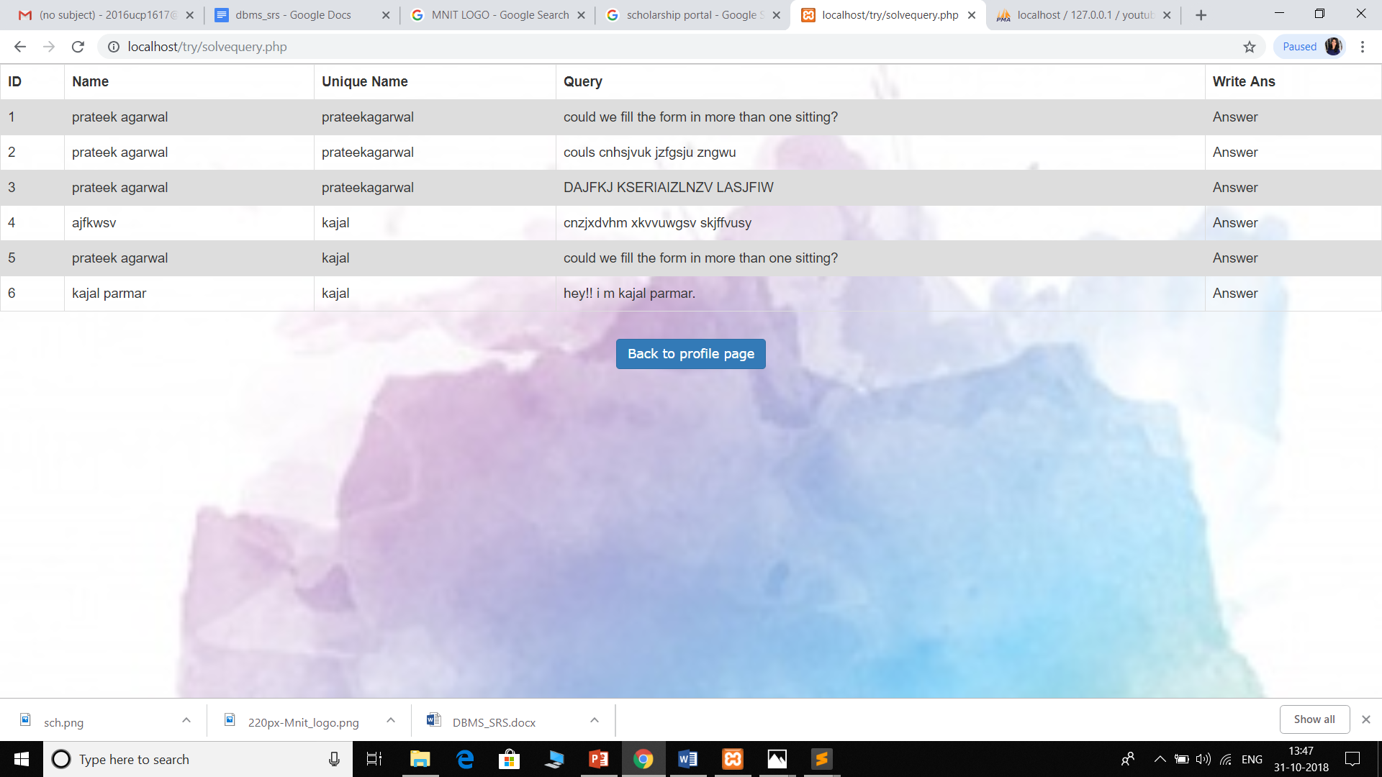
Answer Queries

Slide 30
ER Diagrams
https://docs.google.com/document/d/1uj-3c5yaplzkp4UN3wsBMGAAB9z4UlWRgLQtiNURdAY/edit?ts=5bd8b5cd

Slide 31
Table Schemas

Slide 32
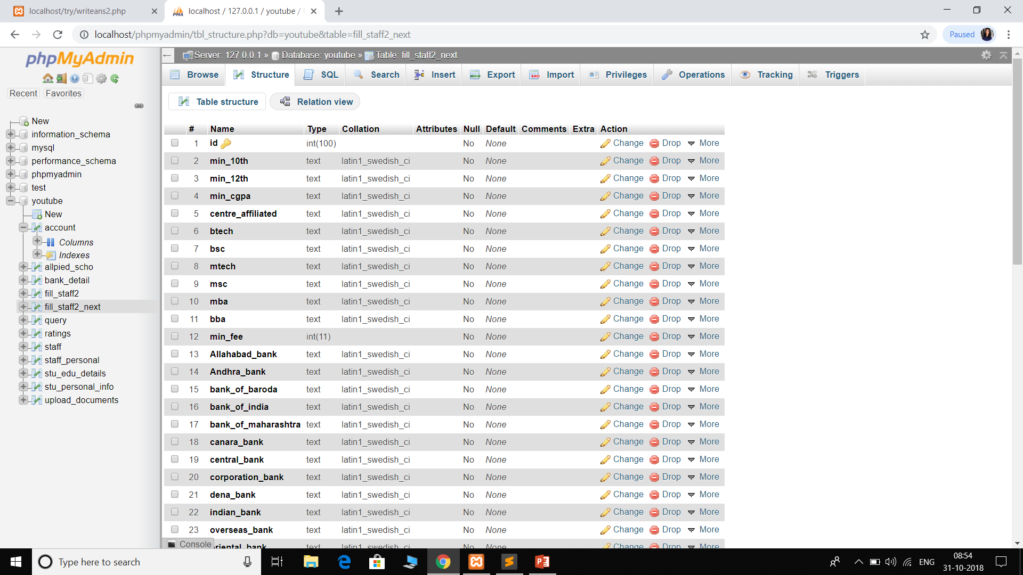
fill_staff2_next

Slide 33
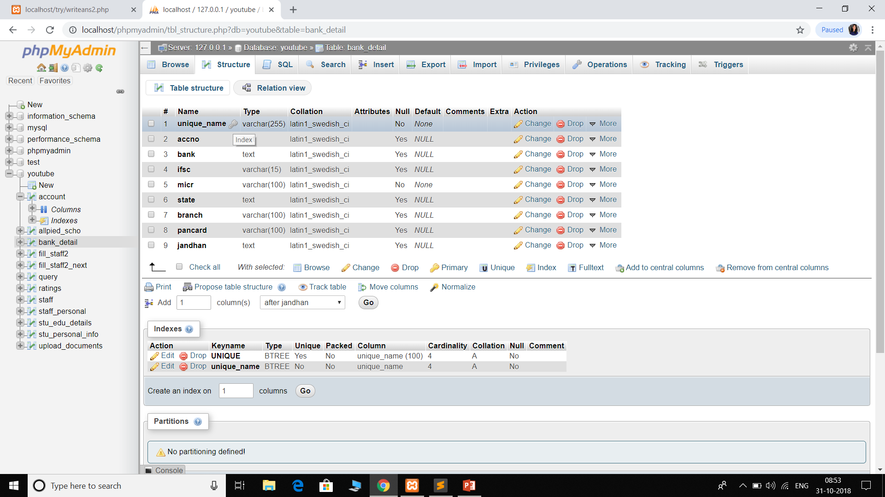
bank_detail

Slide 34
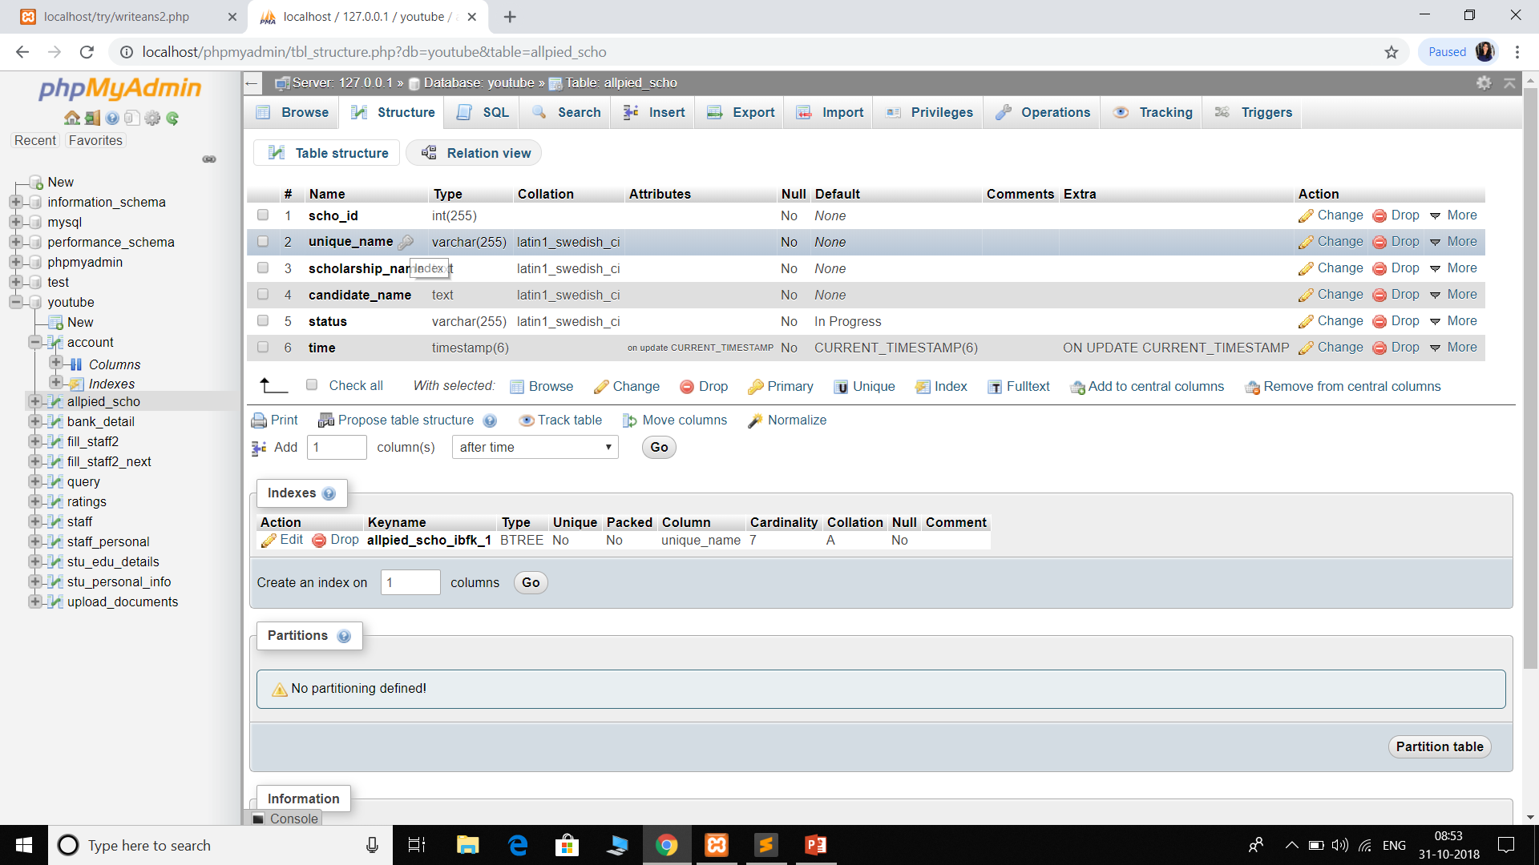
applied_scho

Slide 35
CODE SNIPPETS

Slide 36
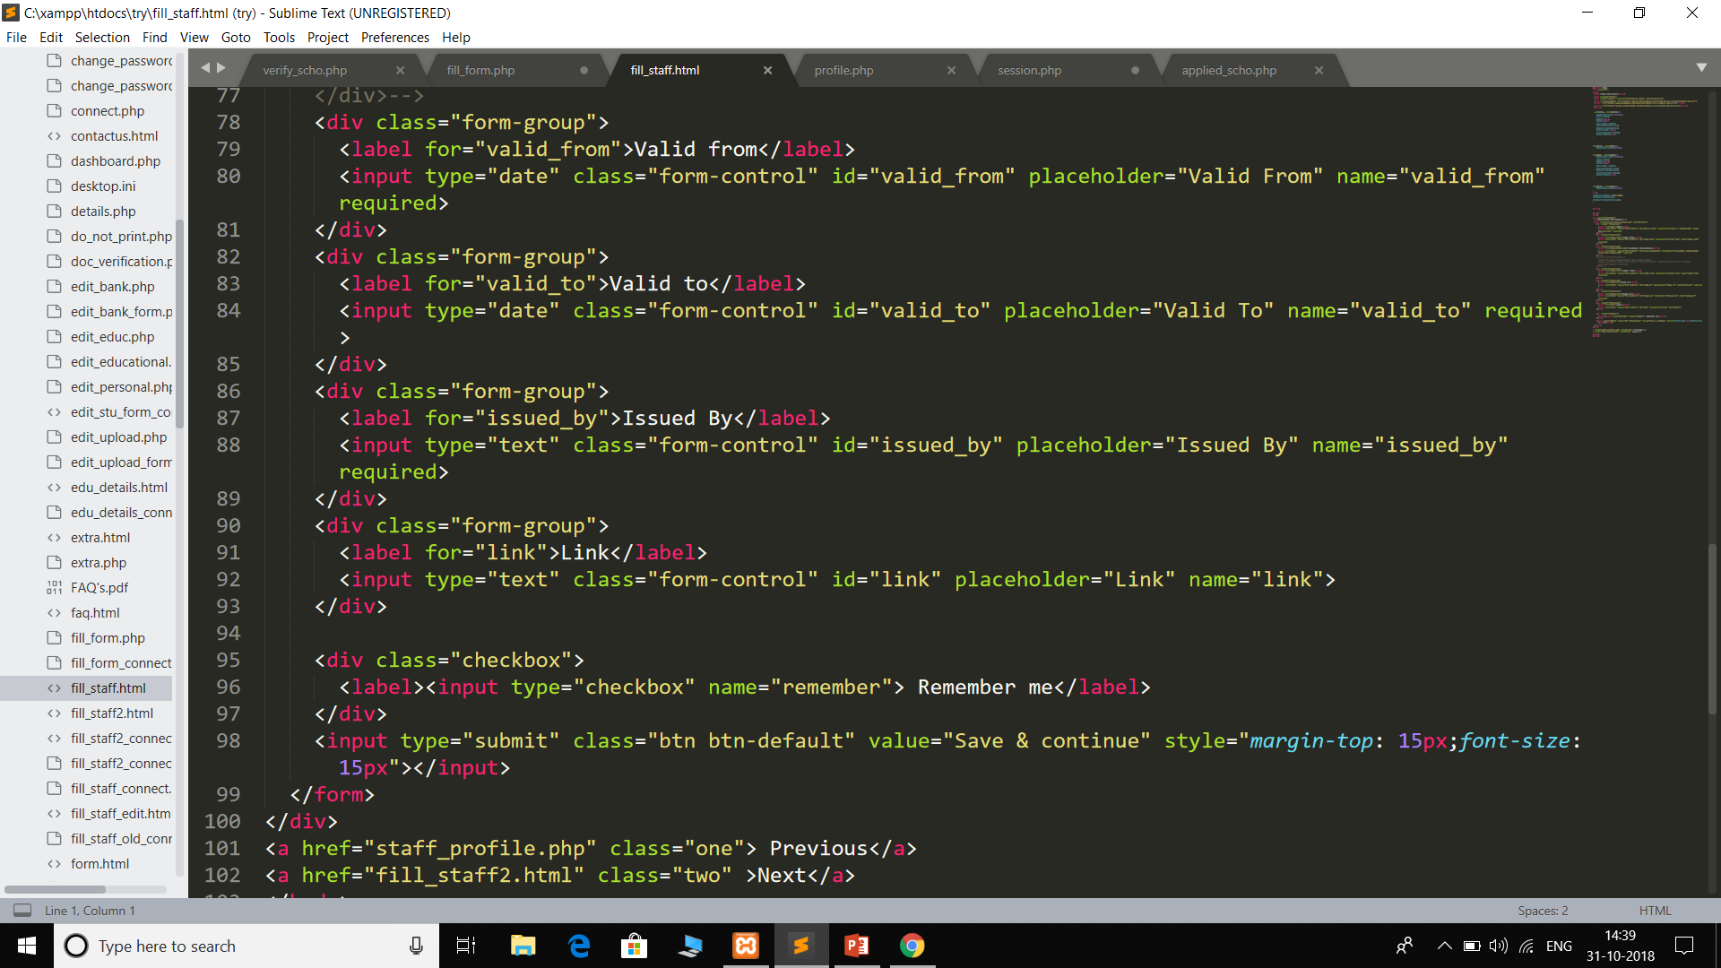

Slide 37
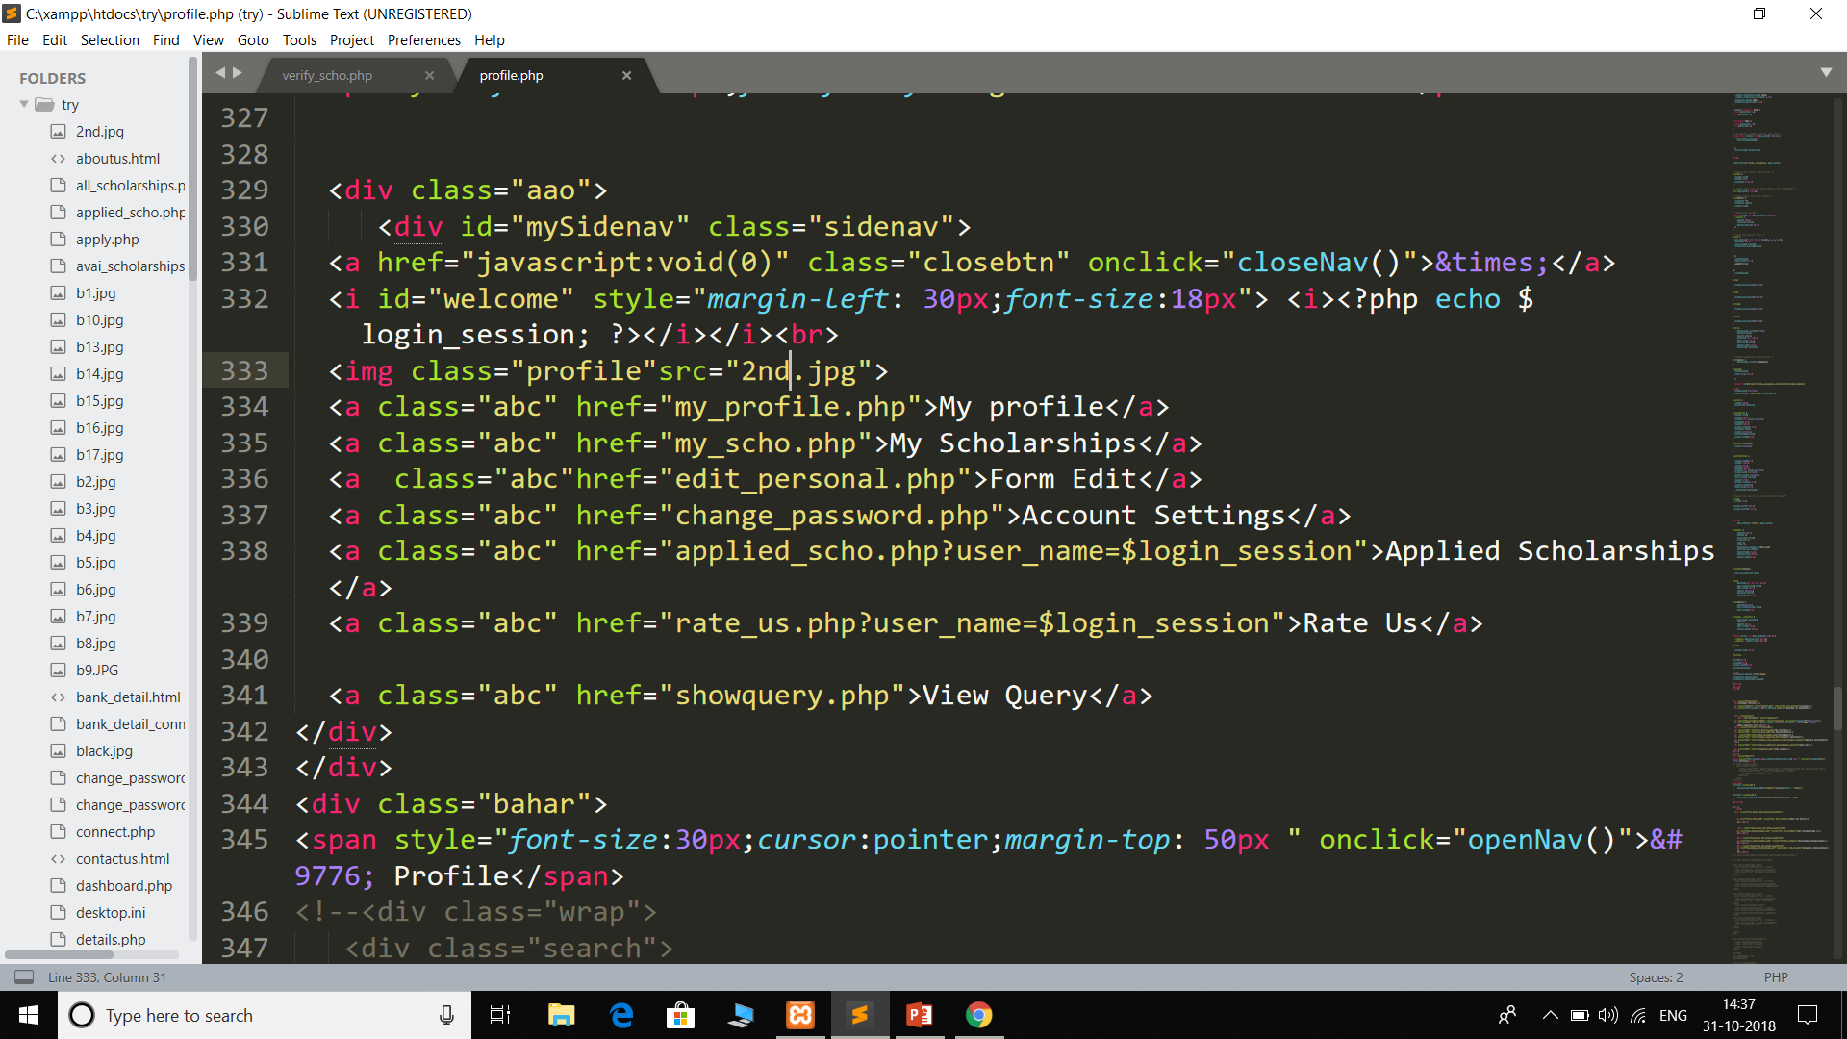

Slide 38
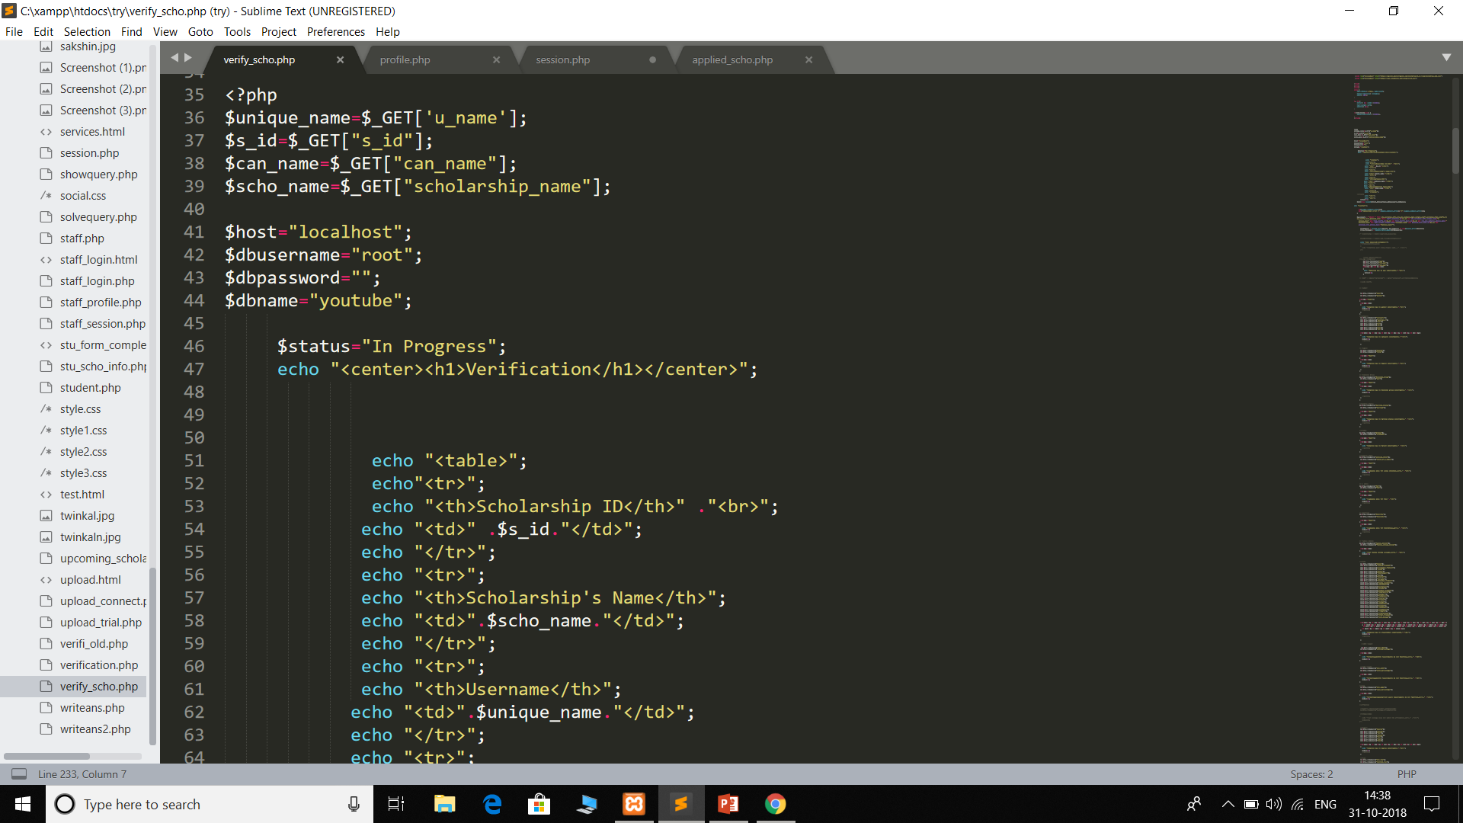

Slide 39
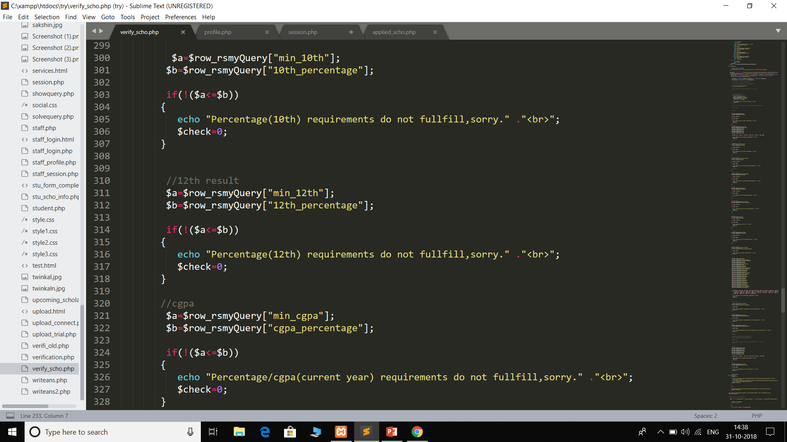

Slide 40
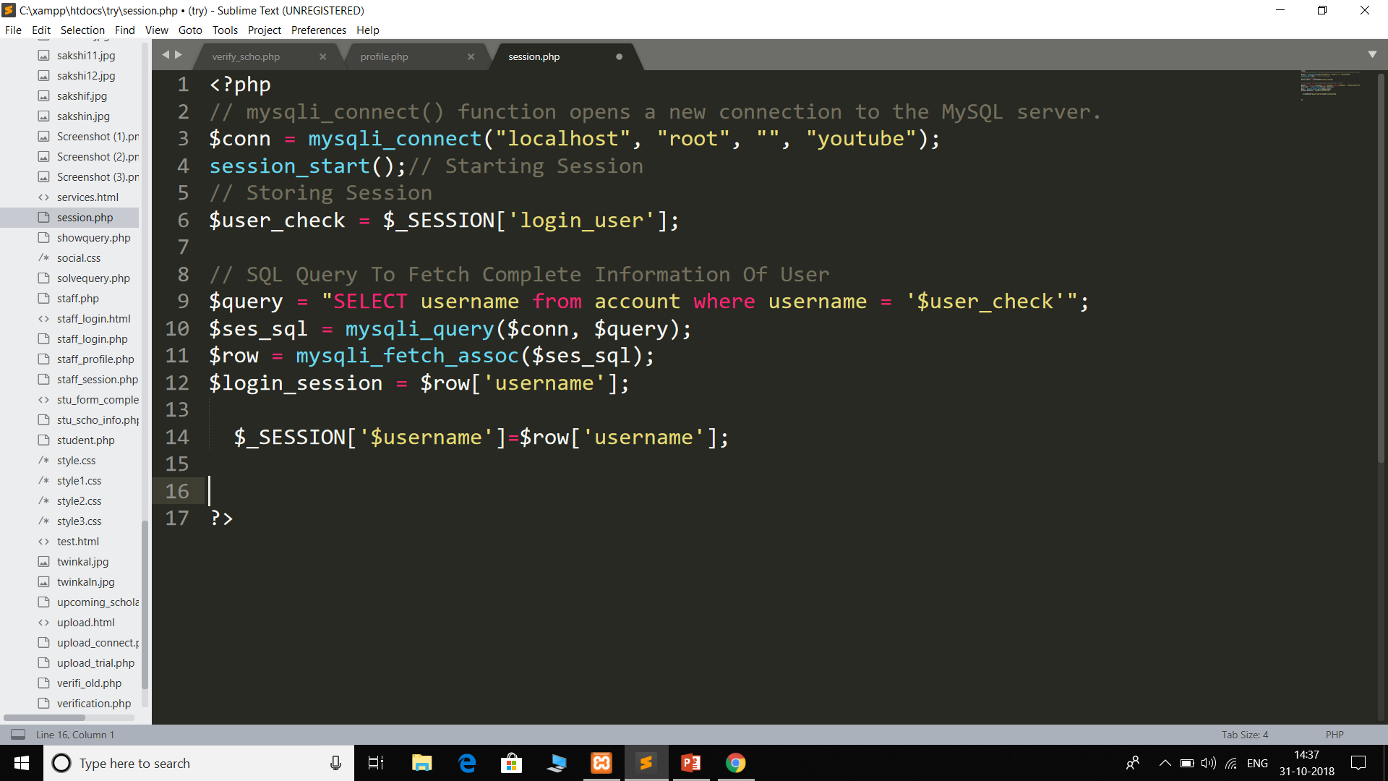

Slide 41
Thank you..

